Slide 1

Student registration portal
Abylaikhan Orazbek
Kadirov Nurdaulet
Niyazbek Omaraliyev

Slide 2

Our goal
Our goal is to create an application as similar as possible to Student Registration Portal. The peculiarity of our application is that it will contain data from the students of the SDU for the time being of our stream and the ability to register new people or change the data at your discretion.

Slide 3

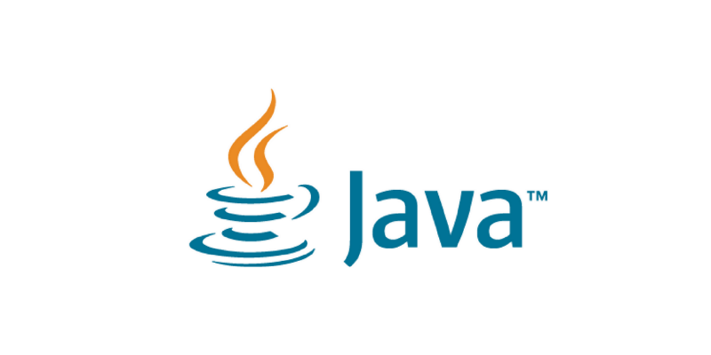
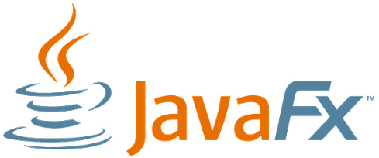
Technologies
Tools and Technologies used: JDK 1.8,PL/SQL Connector Java - 8.0.13,JDBC - 4.2,JavaFX

Slide 4
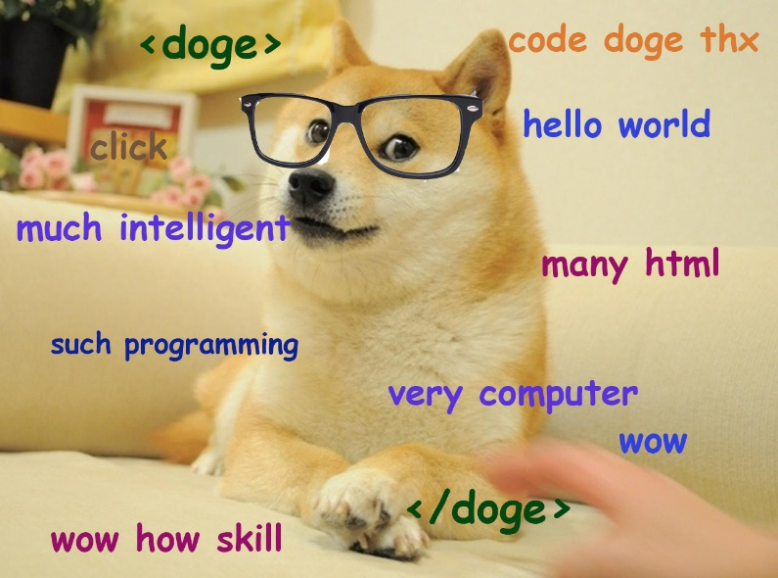
Why did we choose this stack of technologies?
All students at our university start python/java, but since we did not go deep into python, and in java we went through javafx, so we chose java. We chose Pl / SQL because PL / SQL is a procedural language that is an extension of SQL, and it contains SQL statements in its syntax. And the main difference between SQL and PL / SQL is that in SQL one query is executed at a time, while in PL / SQL a whole block of code is executed at the same time.

Slide 5
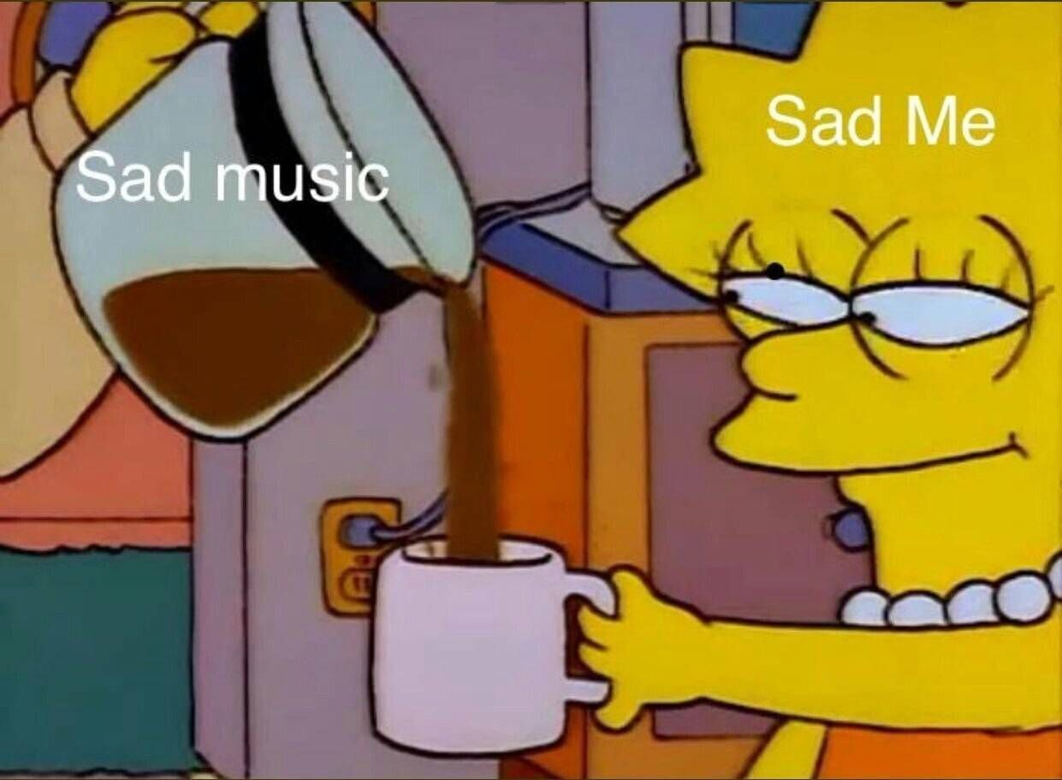
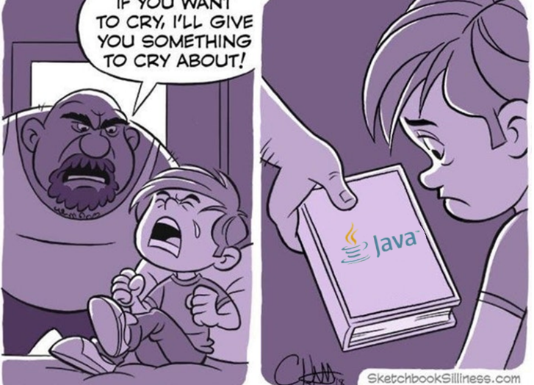
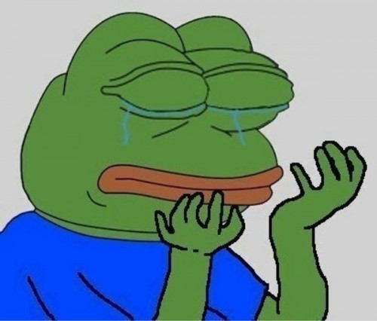
First problems
The first problems happened due to different versions of programs and drivers, we needed to download similar / compatible versions, the next problem arose when installing sql developer, with the help of teamwork we were able to solve problems with installing and downloading

Slide 6
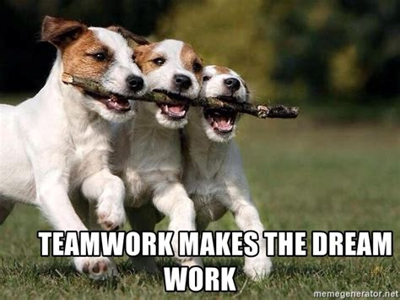
Teamwork
Our team was very close-knit and friendly, we condemned every idea and everyone gave their own ideas about the topic

